Slide 1

Android KTX & PIcasso
Start
Advanced Native Mobile Programming
Week 6
Teknik Informatika - Universitas Surabaya

Slide 2
ANDROID KTX
Android KTX is a set of Kotlin extensions that are included with Android Jetpack and other Android libraries.
Android KTX is an effort by the Google Android team to make the Android APIs more pleasant
Core KTX: for use with framework APIs such as Toasts, Spans, and Menus
Fragment KTX: simplifies Fragment transactions
Palette KTX: for working with color palette APIs
SQLite KTX: simplifies SQLite database transactions
Collections KTX: for use with collection APIs
Navigation KTX: for use with Jetpack Navigation

Slide 3
ANDROID KTX - EXAMPLE
when working with SharedPreferences, you must create an editor before you can make modifications to the preferences data
sharedPreferences .edit() .putBoolean("key", value) .apply()

Slide 4
ANDROID KTX - EXAMPLE
SharedPreferences with the Android KTX Core functions (use the benefit of lambdas)
sharedPreferences.edit { putBoolean("key", value) putBoolean("key2", value2) putBoolean("key3", value3) }

Slide 5
ANDROID KTX - EXAMPLE
In this code we extend simple “Int” class with toNisbi() function that return the alphabetic value based on int value
fun Int.toNisbi(): String { return when { this >= 81 -> "A" this >= 73 -> "AB" this >= 66 -> "B" this >= 60 -> "BC" this >= 55 -> "C" this >= 40 -> "D" else -> "E" } }

Slide 6
ANDROID KTX - EXAMPLE
Notice that KTX extension offers more flexibility compared to traditional class inheritance
var nilai:Int = 83 println(nilai.toNisbi())

Slide 7
ANDROID KTX - EXAMPLE
Android KTX can also extend the View object. For instance, here is the KTX code to extend all TextView with the “Rp” currency prefix
fun TextView.setText(content:String) { this.text = "Rp. $content” }

Slide 8
HOW TO USE ANDROID KTX
On the latest Android Studio, every projects already has dependencies configuration to use Android KTX (the version number may differ)
implementation 'androidx.core:core-ktx:1.7.0'

Slide 9
TUTORIAL
Using Android KTX and Picasso to handle Student Photo
Go!

Slide 10
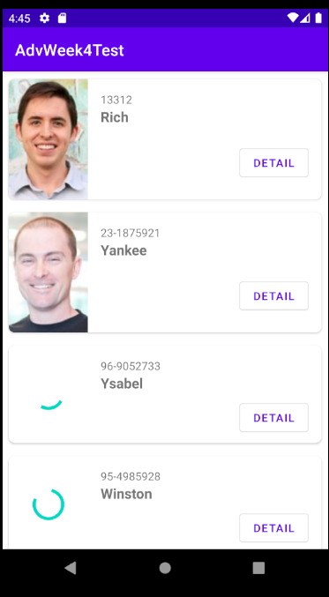

TUTORIAL
DISPLAY IMAGES
ImageView
Using Picasso, we load images for individual student photo into imageview
We extend the imageview to customize the image loading progress indicator
Picasso
Android KTX

Slide 11
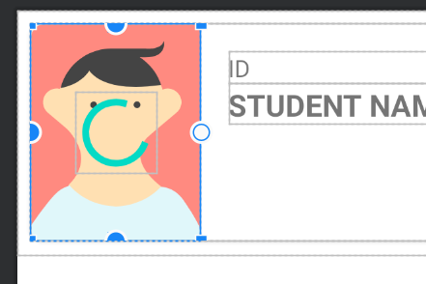
PREPARE THE IMAGEVIEW
Back
Open studentlist.xml, make sure imageView of student photo:
Width = 100dp
ScaleType = “center crop”
Add one progress bar, constrained it at the center of imageview
Id = progressBar

Slide 12
EXTEND THE IMAGEVIEW
Back
The next step is we need to extend the ImageView loadImage functions to handle how the progress bar react to Picasso load image functionality
All of those extensions should be put in the same file. We called it a utility file. However, this utility file should not be placed inside the MVVM package, it doesn't make sense, and it doesn't relate to any of that MVVM
Therefore we could create a new package for this utility file.
Create a new "util" package

Slide 13
UTIL FILE
Back
Create a new “util.kt” file inside of util package
fun ImageView.loadImage(url: String?, progressBar:ProgressBar) {
}
That code is used to extend the loadImage method of ImageView. We passed two things: the image URL, and the progress bar view object

Slide 14
PICASSO LIBRARY
Back
We need to add picasso library into our project. Open build.gradle(module), and add following dependencies:
implementation 'com.squareup.picasso:picasso:2.71828’
Check on this GitHub page on the latest version
Press “sync now” button

Slide 15
USE PICASSO
Back
fun ImageView.loadImage(url: String?, progressBar:ProgressBar) {
Picasso.get()
.load(url)
.resize(400, 400)
.centerCrop()
.error(R.drawable.ic_baseline_error_24)
.into(this)
}
Resize image to 400px wide and use center crop method
In case its failed to load, it uses custom drawable to replace the image (add a new Vector Asset first)

Slide 16
CALL THE MEtHOD
Back
Student_list_item.xml is the layout that used by adapter to render Recycler View item individually. Open the adapter and add following code inside onBindViewHolder method
holder.view.imageView.loadImage(studenList[position].photoUrl, holder.view.progressBar)
We passed two things: the current student photo url, and its progress bar

Slide 17
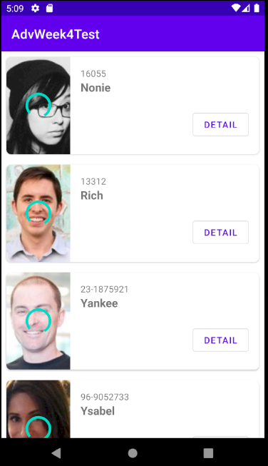
RESULT
It loads up nicely. However, the progress bar still showing even the images finished load

Slide 18
HANDLE PROGRESS
Back
The logic is to hide the progress bar when image finished load. In order to do that, we can use Picasso callback function:
Picasso.get()
.load(url).resize(400, 400).centerCrop()
.error(R.drawable.ic_baseline_error_24)
.into(this, object:Callback {
override fun onSuccess() {
progressBar.visibility = View.GONE
}
override fun onError(e: Exception?) {
}
})
onSuccess is triggered if the image load successfully. When it does, we simply hide the progress bar.

Slide 19
HOMEWORK
Make student detail works
Go!

Slide 20
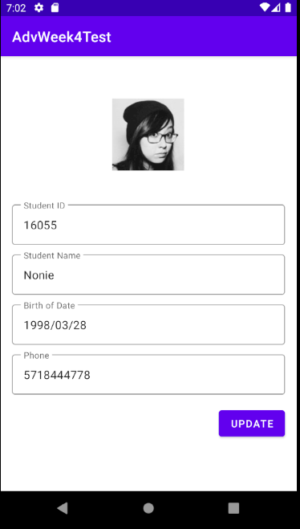
REQUIREMENTS
When detail button is clicked, navigate to student detail and load up selected student data from server

Slide 21
ENDPOINT FOR SINGLE STUDENT
Back
In order to retrieve single student data, you can use following endpoint URL: http://adv.jitusolution.com/student.php?id=[student id]
Where you can replace [student id] with any student id from list

Slide 22
ENDPOINT FOR SINGLE STUDENT
Back
Example: http://adv.jitusolution.com/student.php?id=16055
Output:
{ "id": "16055", "student_name":"Nonie", "birth_of_date": "1998/03/28", "phone": "5718444778", "photo_url": "https://randomuser.me/api/portraits/women/50.jpg" }

Slide 23
ENDPOINT FOR SINGLE STUDENT
Back
Notice that json returned a single object of student. It means you need to tell gson to read only single object.
Hint: val result = Gson().fromJson<Student>(response,
Student::class.java)
Type of Student class

Slide 24
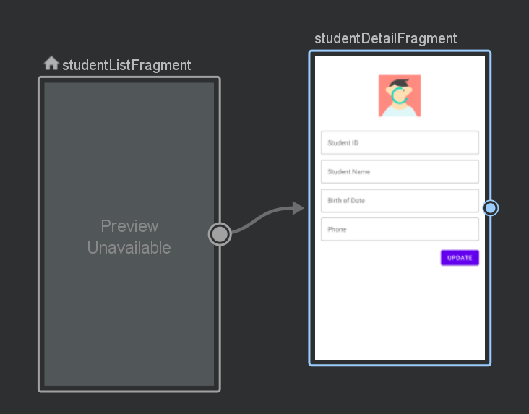
ANOTHER HINT
Back
You may create an argument in the studentDetailFragment navigation graph destination. This argument contains the student id.

Slide 25

DUE DATE
Homework needs to be submitted next week (week 7) “Submitted” means you have to commit and push before the due date

Slide 26
THANKS!
Do you have any questions?
andre@staff.ubaya.ac.id
Please keep this slide for attribution.

Slide 27


